Slide 1
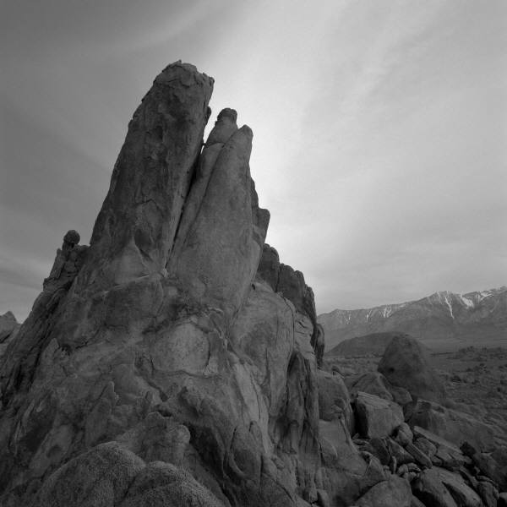
Annotating your research and work

Slide 2
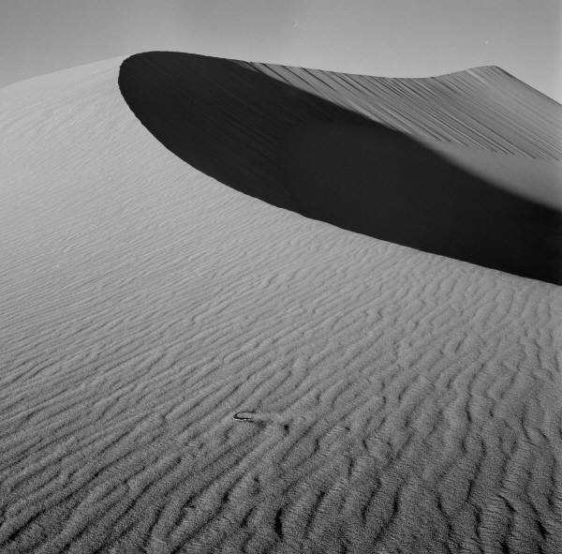
Getting good grades depends on your writing about your work.
Your writing demonstrates your control of your creative process.
Your writing demonstrates your skills.
Your writing indicates connections between aspects of your work and your research.
U – A*

Slide 3
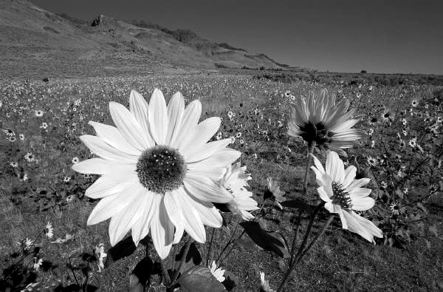
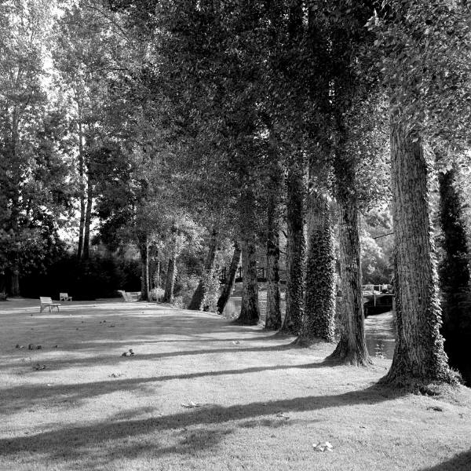
U-C – do we need to talk about this?
This shows a flower and is a close-up picture with black and white colours. The flower is at the front of the image and there’s a low mountain in the back ground.
This photograph is dominated by the flower in the foreground and the tone of the flower balances the darker tones of the shadows behind the sunlit flower and the hillside and clear sky. The profile of the hill frames the landscape whilst the smooth graduation of the sky behind contrasts the textures in the land.
I took this photo showing trees and shadows and I like the shadows on the ground and the shapes in the picture.
I took this photograph as I was experimenting with shapes, tones and textures in my black-and-white photography. I wanted to make a high contrast image with contrast shown between the tones and texture of the ground when compared with the tree and leaves. The exposure was altered slightly in post-processing to make sure there was detail in the shadows cast by the trees.

Slide 4
The Formal Elements of Photography
When you describe (or analyse) a photograph you should look at this list and decide which you can discuss…
Colour
Tone
Line
Light
Shape(s)
Pattern
Texture
E – A*

Slide 5
The Process of Making the Photograph
I took this picture and copied it into my computer. In Photoshop I used the black-and-white adjustment layer to make it black and white. I also made a change in levels.
I post-processed the colour original of this image using Photoshop CS6 as I wanted to concentrate the viewer on the textures of the flower when compared with the texture of the field and hillside in the background. First of all I cropped the image to place the flower in the bottom left of the image. I also altered the levels to ensure that there was enough detail in the texture of the flower. I was also aware of the balance between the smooth texture of the sky and the lighter flower.
C – A*

Slide 6
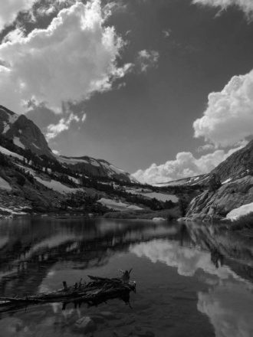
Describing The Mood
The mood of this picture is sunny and peaceful and I like this.
This photograph has a calm and reflective feel to it. These words are literal but also effect the mood of the viewer when they look at this photograph. Keeping the image black-and-white is also beneficial as I am not distracted by colours. The composition is quite symmetrical and this adds to the peaceful and balanced appearance.
B – A*

Slide 7
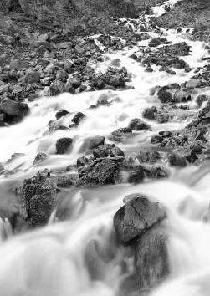
Connections & Development
This is like my other pictures and I will do more like this.
I have taken this image in response to my earlier research on Ansel Adams. I have concentrated on composition and contrast after converting the image to black-and-white. This develops ideas I have shown in my third set of landscape images. I am pleased with the development of my initial idea and see real progress in the even contrast range from blacks through to whites in the photo’s tones.
Taking this appearance into my work on urban landscape is my next challenge and I look forward to completing this work and including in my portfolio.
C – A*

