Slide 1
Writing About Photography
Connections
Analysis
Explanation – Motivation & Intention
GCSE - 2016

Slide 2
When your work is marked…
There are 4 assessment objects that you MUST meet –
AO1 - Develop their ideas through investigations informed by contextual and other sources, demonstrating analytical and cultural understanding.
AO2 - Explore and refine their ideas through experimenting and selecting appropriate resources, media, materials, techniques and processes.
AO3 - Record ideas, observations and insights relevant to their intentions in visual and/or other forms.
AO4 - Present a personal, informed and meaningful response demonstrating analytical and critical understanding, realising intentions and, where appropriate, making connections between visual, written, oral or other elements.

Slide 3
AO1 - Develop
Develop your ideas through investigations informed by contextual and other sources, demonstrating analytical and cultural understanding.
CONTEXTUAL AND OTHER SOURCES = work by photographers, artists, designers, craftspeople or architects, as well as cultural objects and artefacts
CULTURAL UNDERSTANDING = the context of a work -
when and where it was produced
how it reflects its cultural background
how it shows different ways of seeing the world in visual terms
the work's purpose and meaning
its symbolic, spiritual or practical function or significance
its personal, social, historical or vocational significance

Slide 4
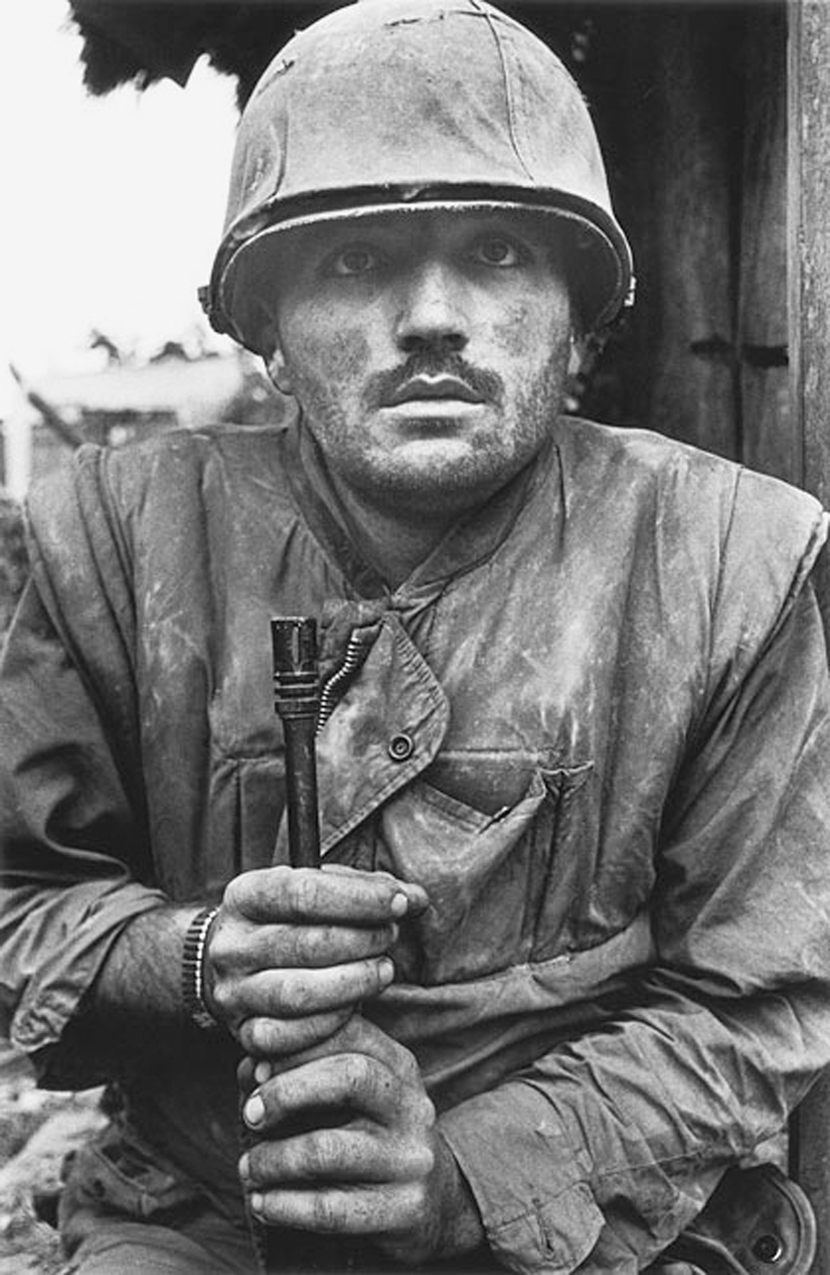
AO1 – Develop EXAMPLE
This photograph was taken by Don McCullin in 1968 of an American solider fighting in the Vietnam War. The soldier is traumatized by war and this photograph captures that emotion. It can be seen as an anti-war photograph as well as one showing the suffering of soldiers. This is a significant image as it showed the world the real effects of war on soldiers and added to the feeling in America that Vietnam was a bad war. In my portraits I want to capture emotions in a direct way using this kind of composition and directness.

Slide 5
AO1 – Develop EXAMPLE
This photograph was taken by Don McCullin in 1968 of an American solider fighting in the Vietnam War. The soldier is traumatized by war and this photograph captures that emotion. It can be seen as an anti-war photograph as well as one showing the suffering of soldiers. This is a significant image as it showed the world the real effects of war on soldiers and added to the feeling in America that Vietnam was a bad war. In my portraits I want to capture emotions in a impactful way using this kind of composition and directness.

Slide 6
AO2 - Explore
Explore and refine their ideas through experimenting and selecting appropriate resources, media, materials, techniques and processes.
APPROPRIATE = suitable or proper in the circumstances.

Slide 7
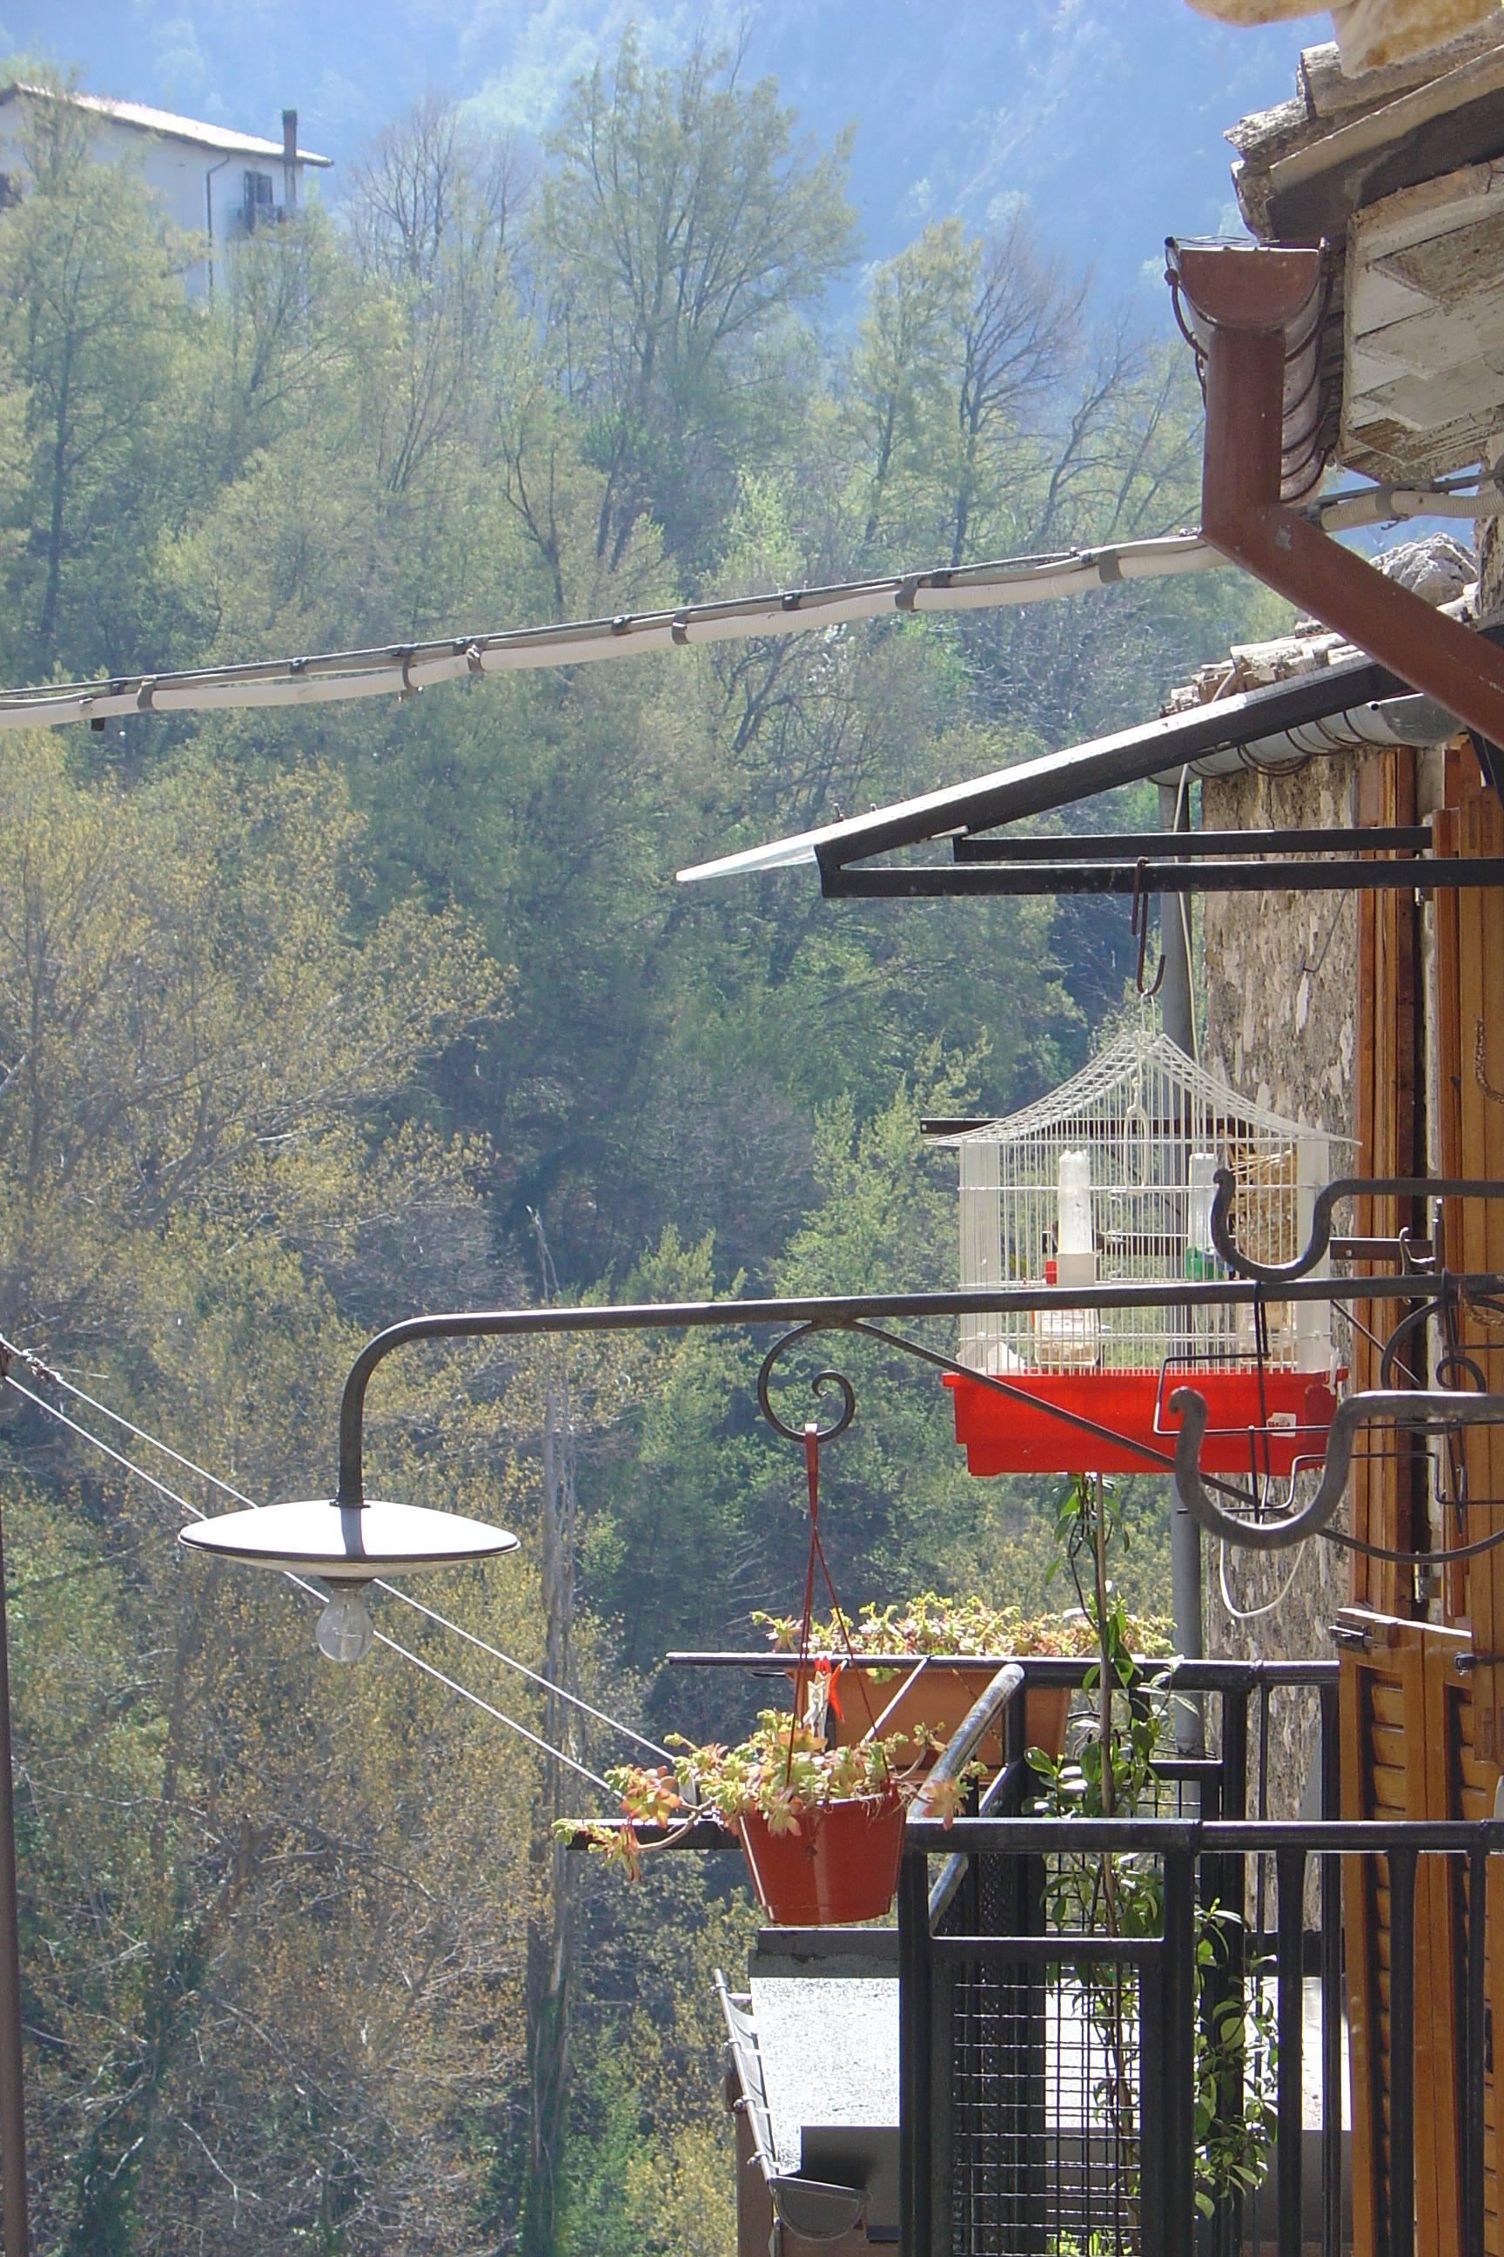
AO2 – Explore EXAMPLE
This photograph was taken in an Italian mountain village. I wanted to fill the frame with village and landscape with no sky visible. The image was also over-exposed so I could get detail in the shade of the balcony. This gives the sunny parts a kind of glow which suggests a hot day. The composition shows the building along the right edge of the frame – I did this to emphasize the upright shape of the picture. The picture has not been changed at all in Photoshop.

Slide 8
AO3 - Record
Record ideas, observations and insights relevant to their intentions in visual and/or other forms.

Slide 9
AO3 – Record EXAMPLE
This set of photos was all about me making photos that show a sunny and hot feeling. I visited one village and took time to capture the quiet and hot feeling there. My theme is around weather and this set are successful as they seem so bright and show summer. This work has been influenced by my research of Martin Parr and the bright colours seen in his work. I have aslo been inspired by the careful compositions and framing that I have written about in my research of Kertesz and Cartier Bresson.

Slide 10
When your work is marked…
You must meet certain criteria –
The 4 assessment objectives – read them; understand them and check your writing against each one.
AO4 – to be considered and discussed later this academic year…

Slide 11
When your work is marked…
You must meet certain criteria –
Develop your ideas through investigations informed by contextual and other sources, demonstrating analytical and cultural understanding.
CONTEXTUAL AND OTHER SOURCES = work by photographers, artists, designers, craftspeople or architects, as well as cultural objects and artefacts
CULTURAL UNDERSTANDING = the context of a work of art, craft or design. You could present research on:
when and where it was produced
how it reflects its cultural background
how it shows different ways of seeing the world in visual terms
the work's purpose and meaning
its symbolic, religious, spiritual or practical function or significance
its personal, social, historical or vocational significance

