Slide 1
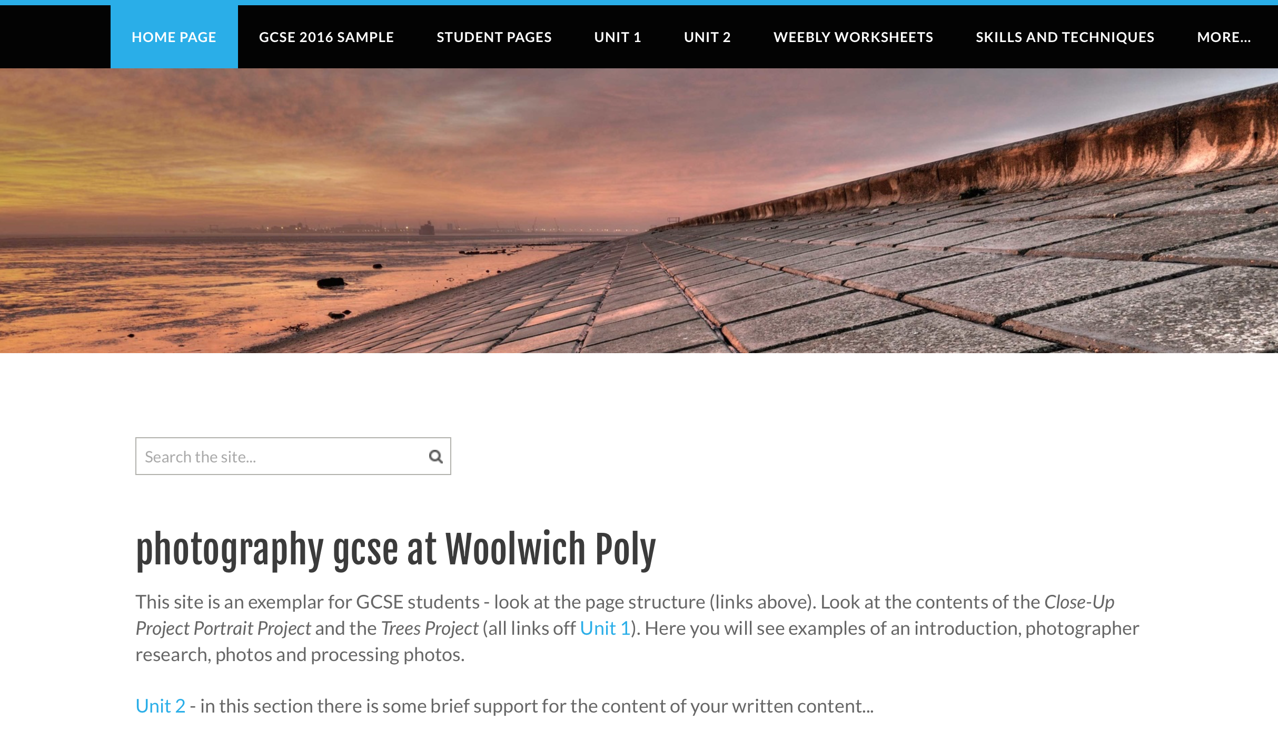
Check through your sites and make an (HONEST) list of work needing to be done
You need to look at every part of your website and make a list (on paper) of incomplete pages; photographs not yet uploaded and spend time looking at exemplar pages on the POLYGCSEPHOTO website.
polygcsephoto.weebly.com
Ask for some paper and make sure you put your name at the top – all work should be handed in at the end of the lesson.

Slide 2
If time allows…
You should visit the following websites for some inspiration and note down names/website addresses of artists/photographers whose work could help you in yours.
saatchiart.com
thisiscollosal.com

