Slide 1
Today
You have a feedback sheet with targets for today’s lesson. Hit the targets!
Use the Poly GCSE website to support your writing if you are struggling –
http://polygcsephoto.weebly.com

Slide 2
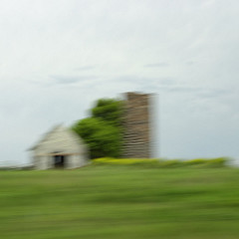
Matthew
Make sure all your work (and accompanying notes) is uploaded to your site.
You should also have research in your site for at least one artist/photographer – I suggest you begin with Ernst Haas (US photographer who made abstract photographs and movement was something that he captured in city photos and Matt Niebuhr (US photographer who has taken lots of photographs of farm buildings and some are taken from a moving car)

Slide 3
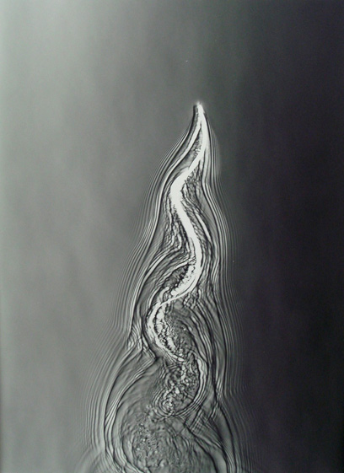
Thai
Make sure all your work (and accompanying notes) is uploaded to your site.
You should also have research in your site for at least one artist/photographer – I suggest you begin with Adam Fuss (http://www.cheimread.com/artists/adam-fuss).

Slide 4
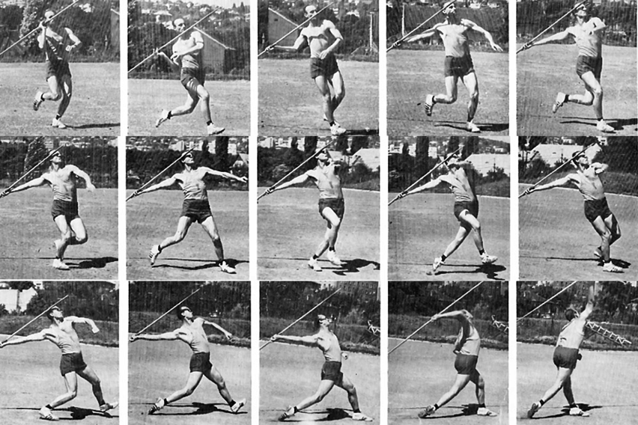
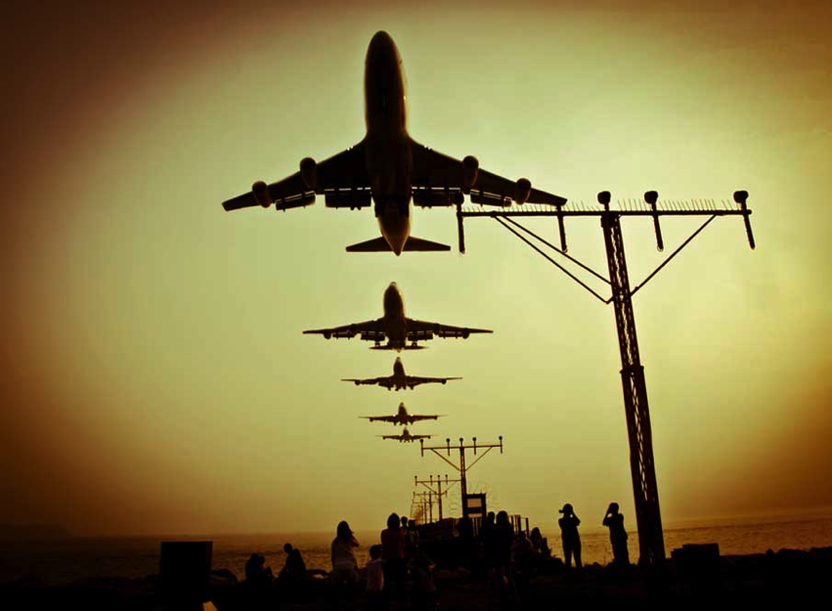
Shafari
Make sure all your work (and accompanying notes) is uploaded to your site.
You should also have research in your site. I suggest you start by researching how sequence photography is made – what techniques are used in camera as well as in Photoshop.

Slide 5
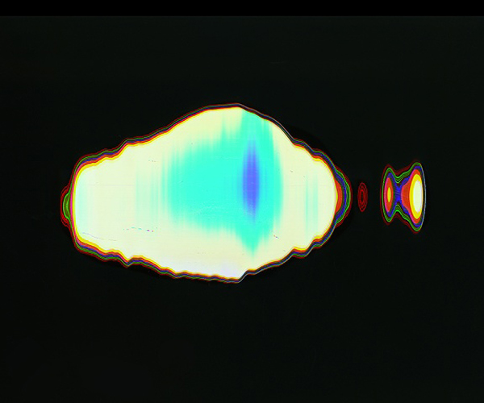
Harry K
Make sure all your work (and accompanying notes) is uploaded to your site.
Make a list for yourself of pages on your site that need your notes adding or pages that need to be added with notes/photography.
For your research you need to add notes about all photographers.

Slide 6
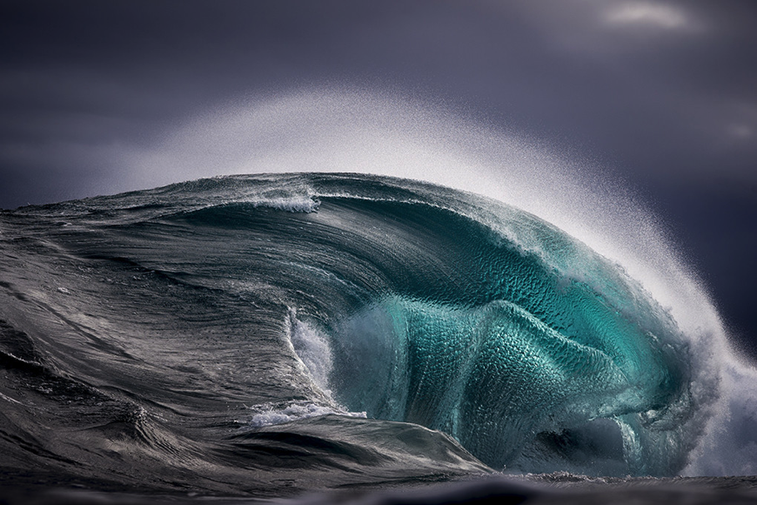
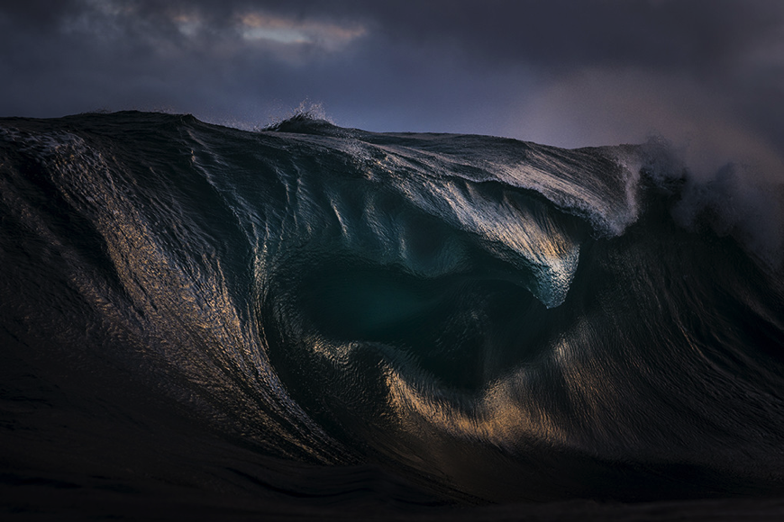
Jamie
Make sure all your work (and accompanying notes – these need expanding) is uploaded to your site.
For your research you need notes/images to your page on Ray Collins. Also look at the work of Adam Fuss

Slide 7
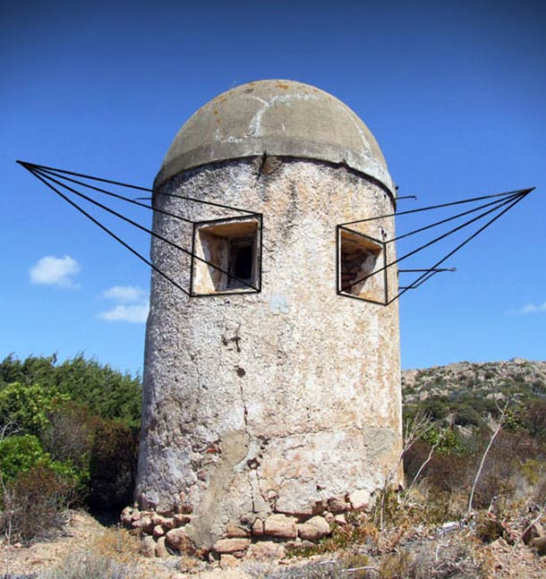
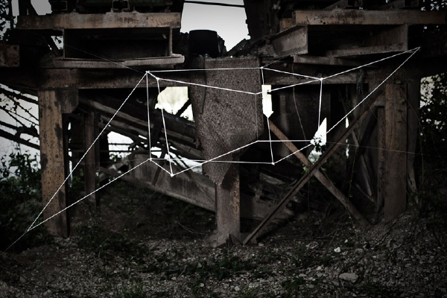
Purna
Make sure all your work (and accompanying notes – these need expanding) is uploaded to your site.
For your research on ‘moneyless’ could you add some notes about how you could use some of those ideas in your work.

Slide 8
Ghulam
You need to add a new page to your site called ‘Movement’.
Put a gallery on that page and add your last movement images to that gallery.
Give the page a title (Movement – First Set of Photographs).
Add some single words which describe your pictures.

Slide 9
Owen
Add a proper introduction outlining what your initial ideas are.
Add some images in a gallery based on a search using Google to show some ideas that correspond with your written introduction.
Use ‘art2day.co.uk’ to find at least 3 artists/photographers whose work can influence your first practical work. Add their names to a new page in movement called ‘Research’.

Slide 10
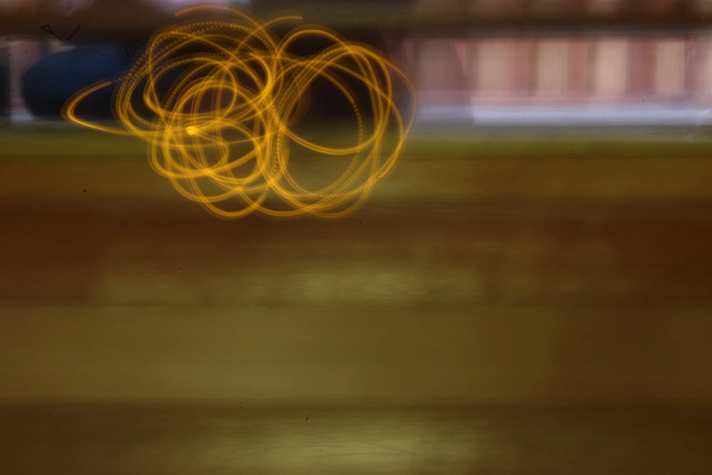
Bradley
Make sure all your work (and accompanying notes) is uploaded to your site. Your notes are badly lacking at the moment – use today to catch up on notes about your work as well as your research.
I suggest you also change the ‘theme’ of your website.
Remove the Weebly headers!!!

Slide 11
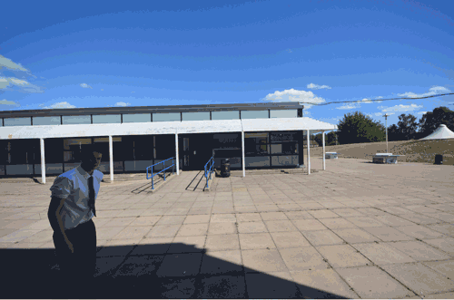
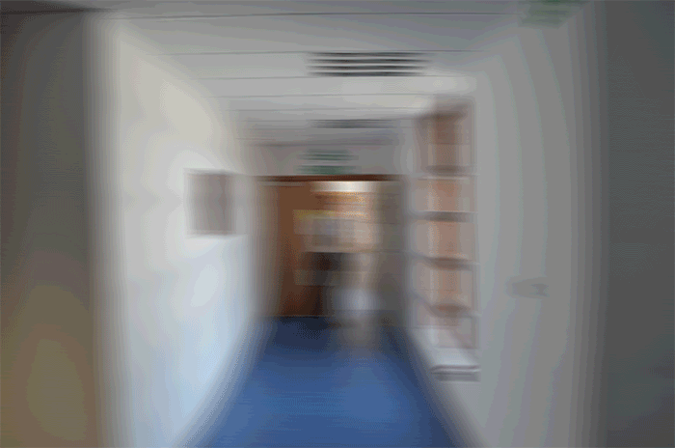
Harry P
Your research page is empty – you need to add something here. I suggest you start by using Google to find examples of sotp animations (Hannah Guy has 2 examples – forest floor and glow).
Add a gallery to one of your films showing the still images that make up the animation.
Make sure all pages have completed notes.

Slide 12
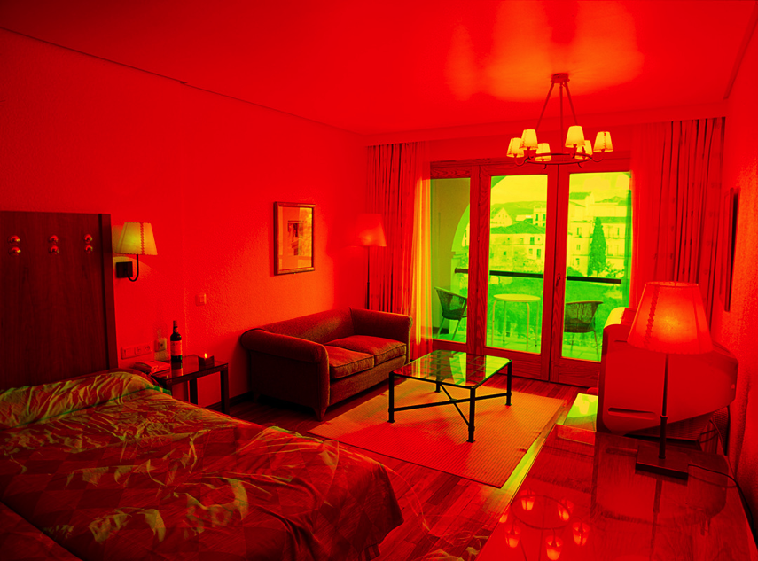
Morgan
Make sure all your work (and accompanying notes) is uploaded to your site – specifically your ‘Clouds’ images.
In ‘Clouds’ – could you add a gallery showing more of the images and their appearance before you worked on them.
Make connections between your clouds and Brad Carlile (colour shifting).

Slide 13
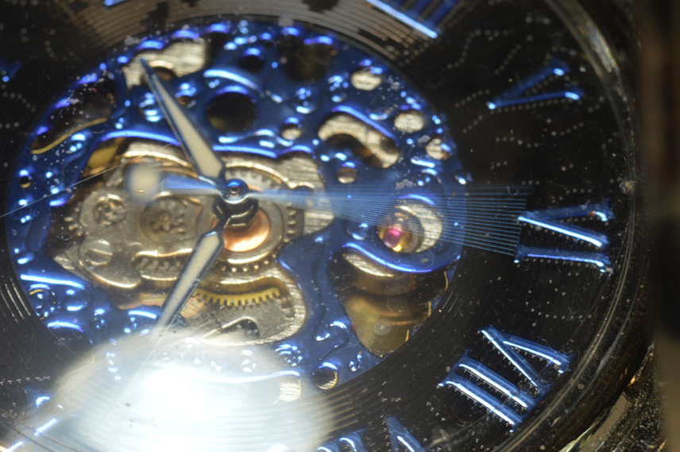
Mitchell
Make sure all your work (and accompanying notes) is uploaded to your site.
Set 2 needs notes and here you can put the idea forward of your project being based exclusively around an ongoing investigation of the watch.
Plan your next work as well.
Research – I suggest you start with Leopoldo Plentz. This leads on to you taking some simple photography of the watch – I am not saying the watch is rubbish!!!

